Slide 1
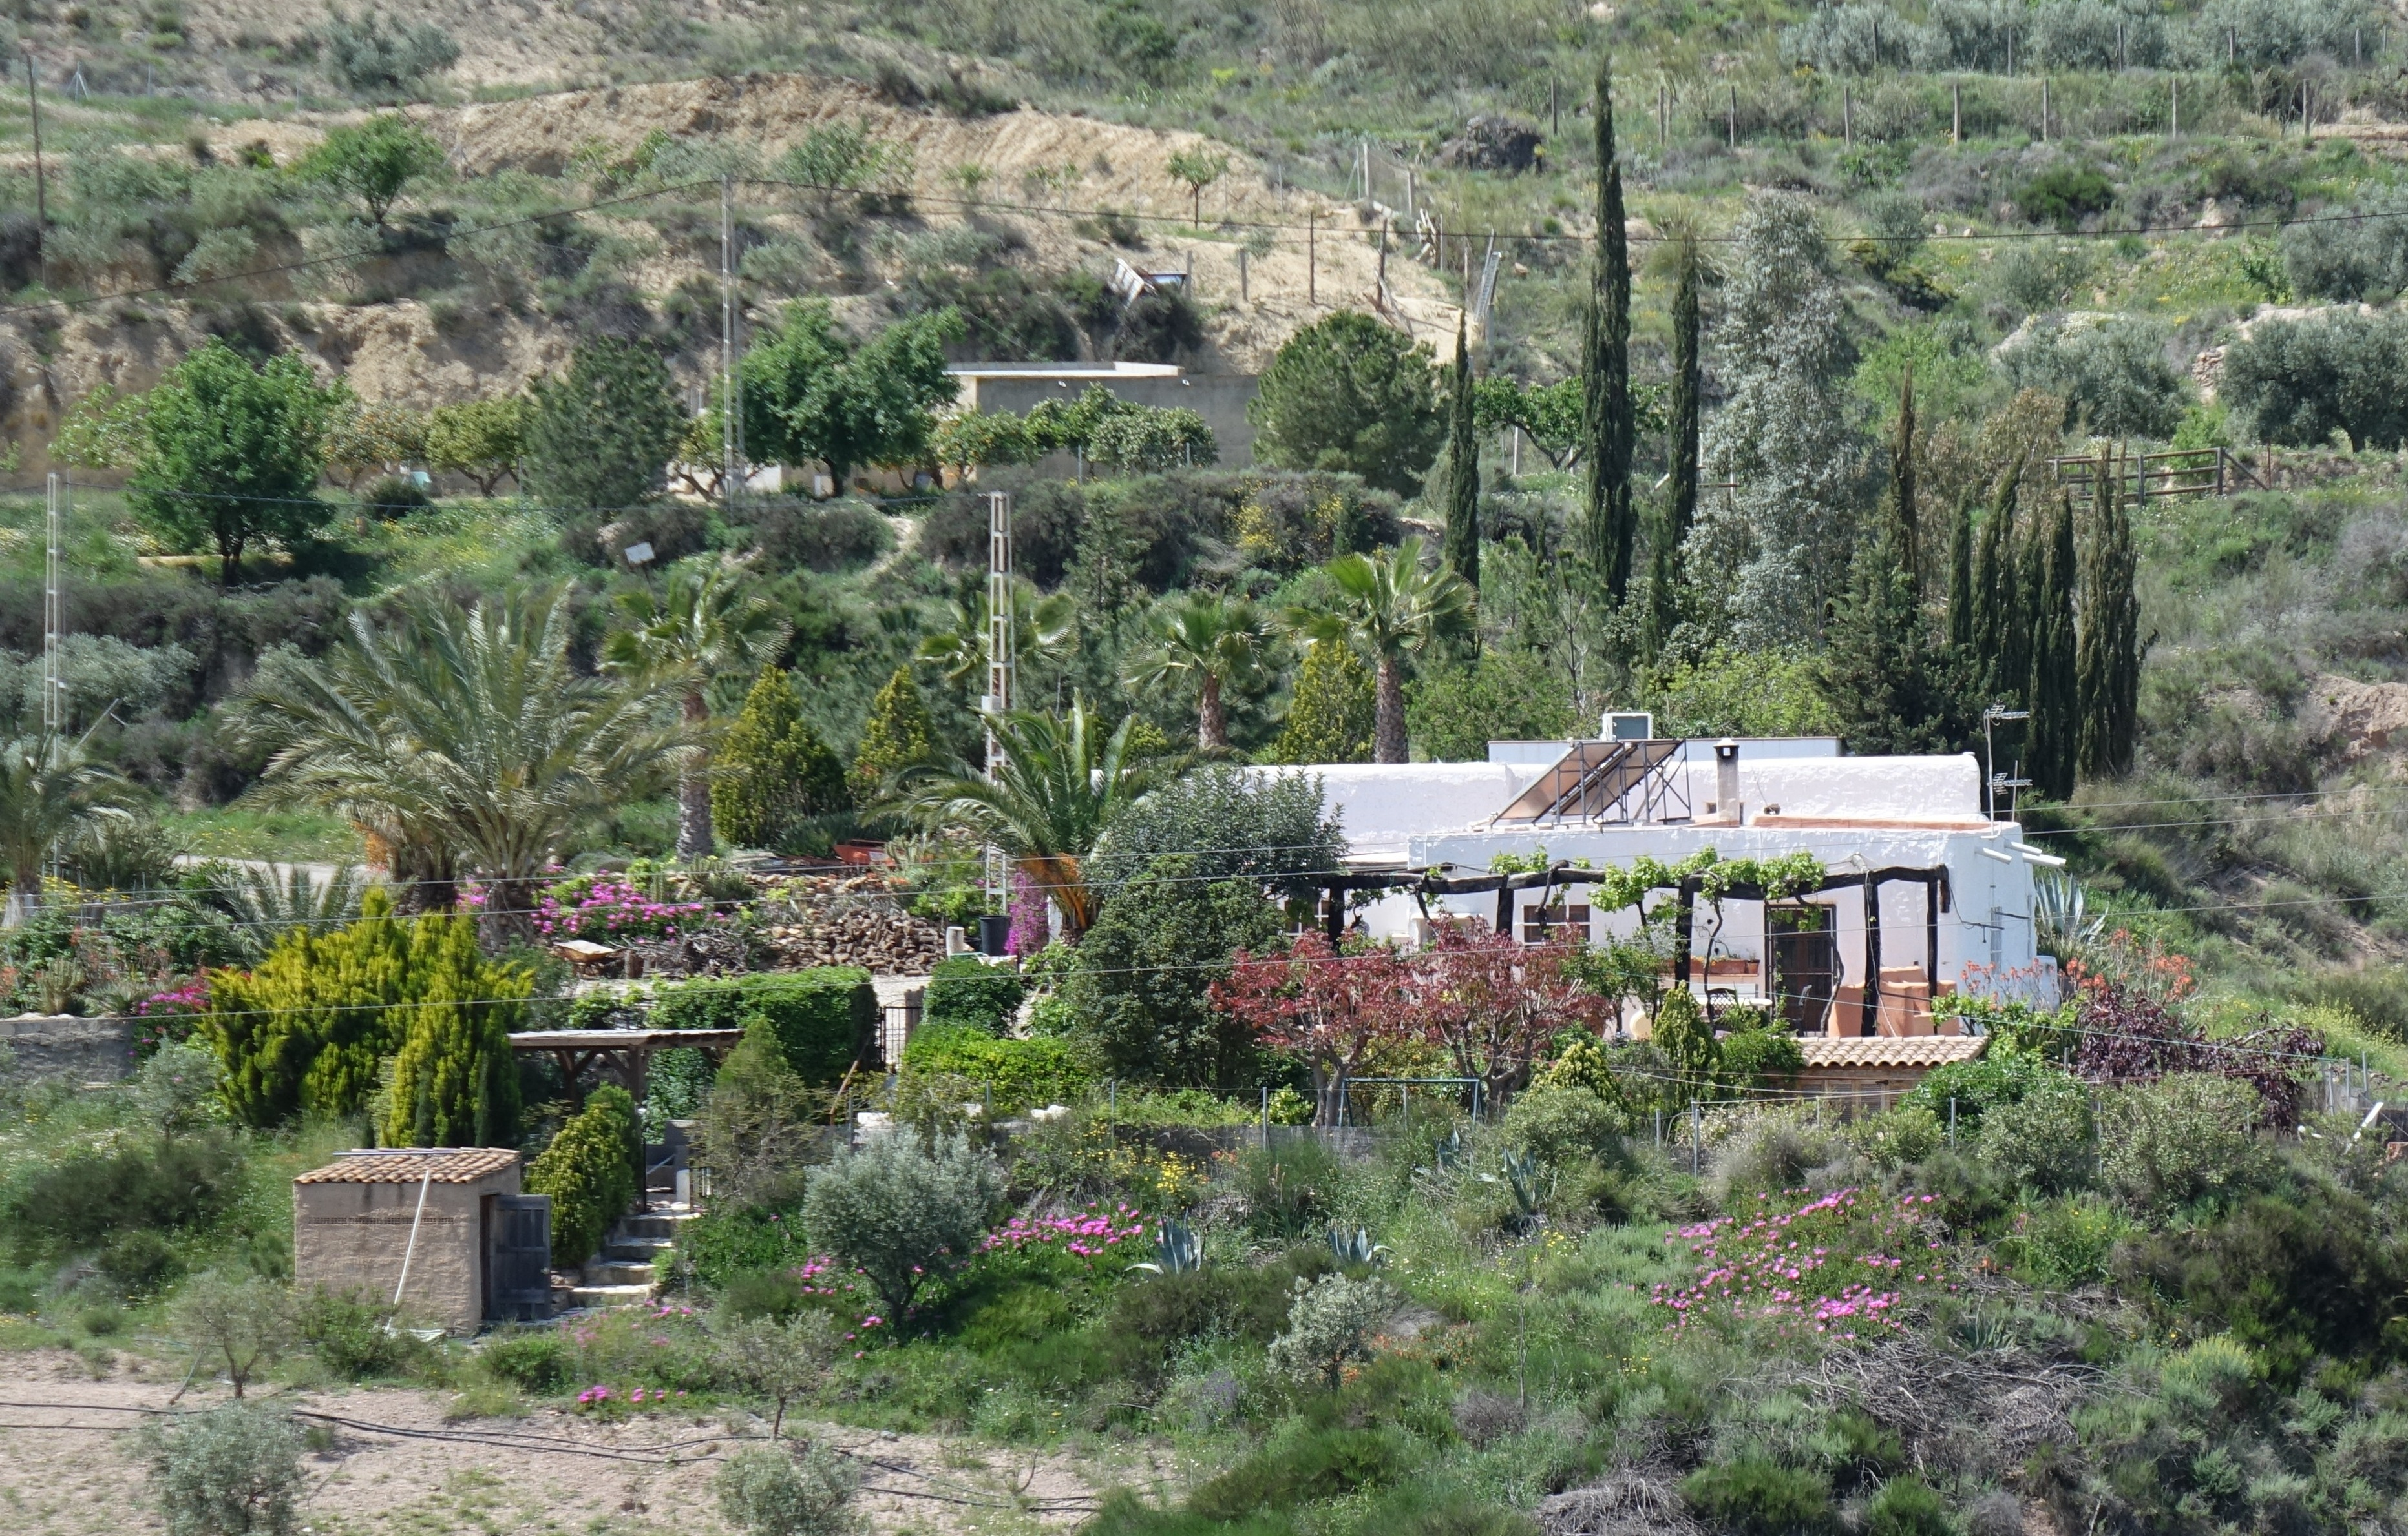
Cerradilla from the north
Cerradilla is an old property the lower main house in front of the picture has half-metre thick stone and mud walls – useful for keeping summer heat out and winter warmth in!
In front of the picture (left) is the filter room for the plunge pool.

Slide 2
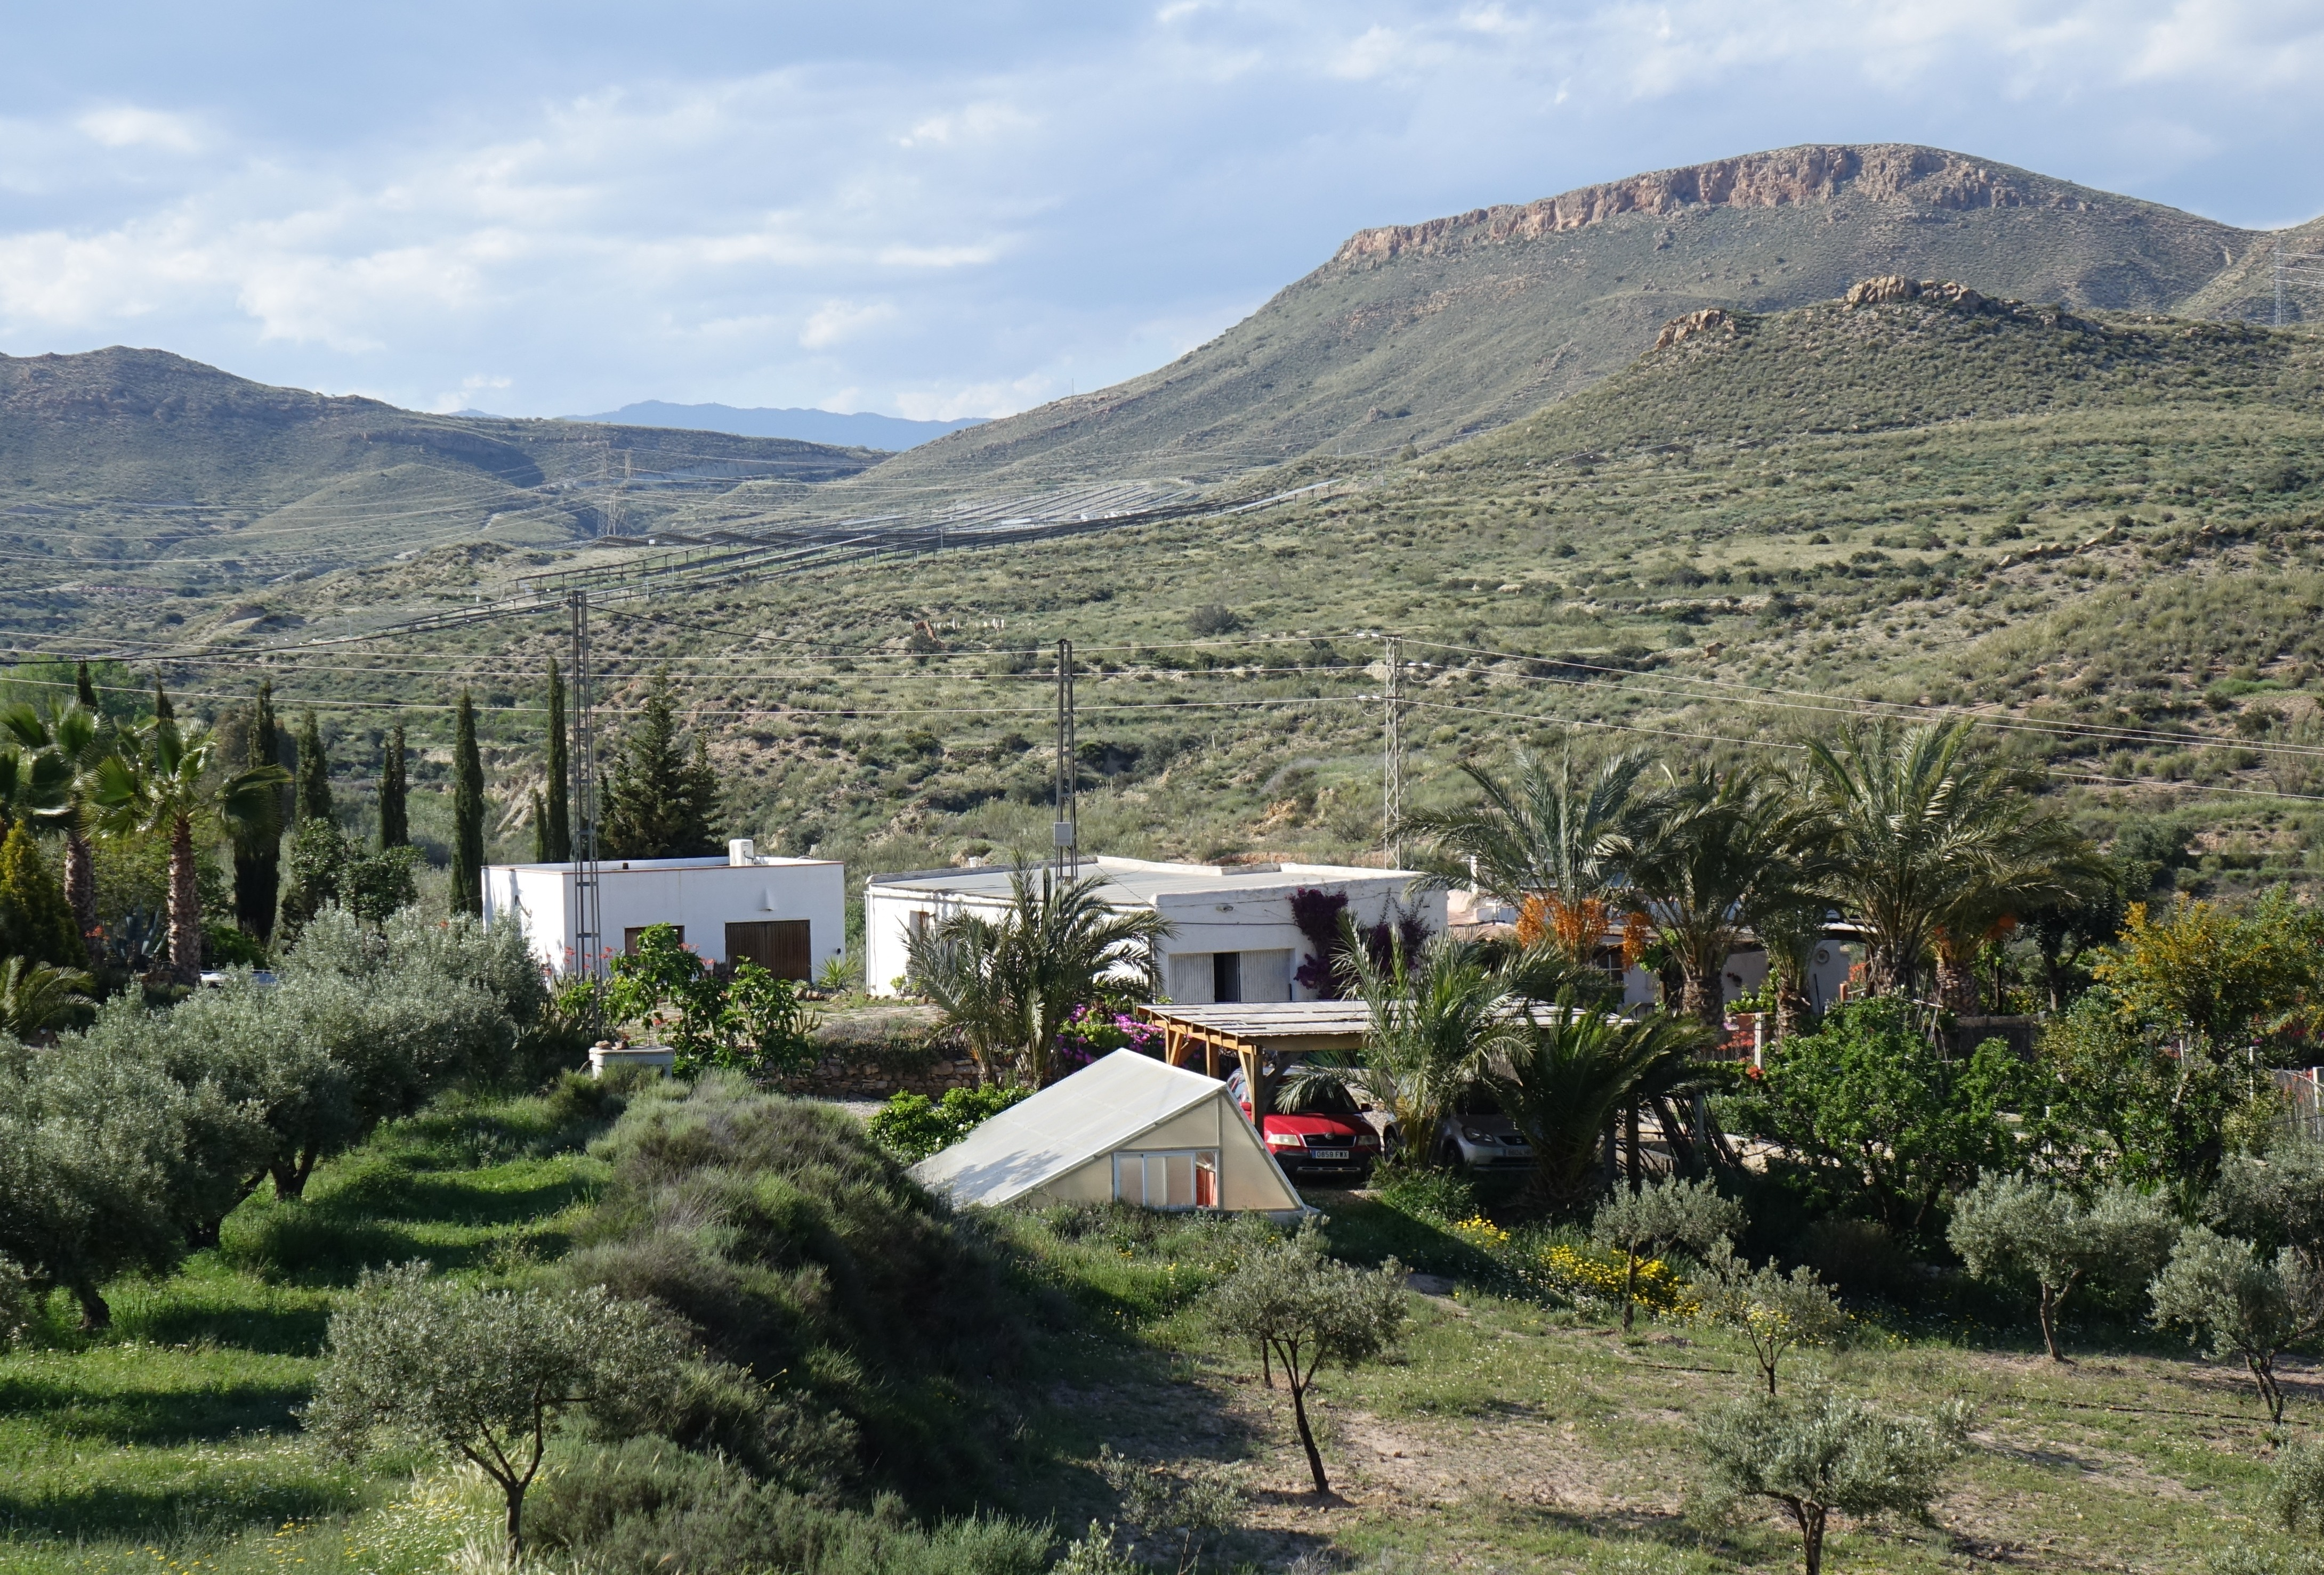
Cerradilla from the South-east
In the far distance are the 2000-metre tall Filabres.
The photo is taken from about 480 m above sea level
The main house is behind the palm trees

Slide 3
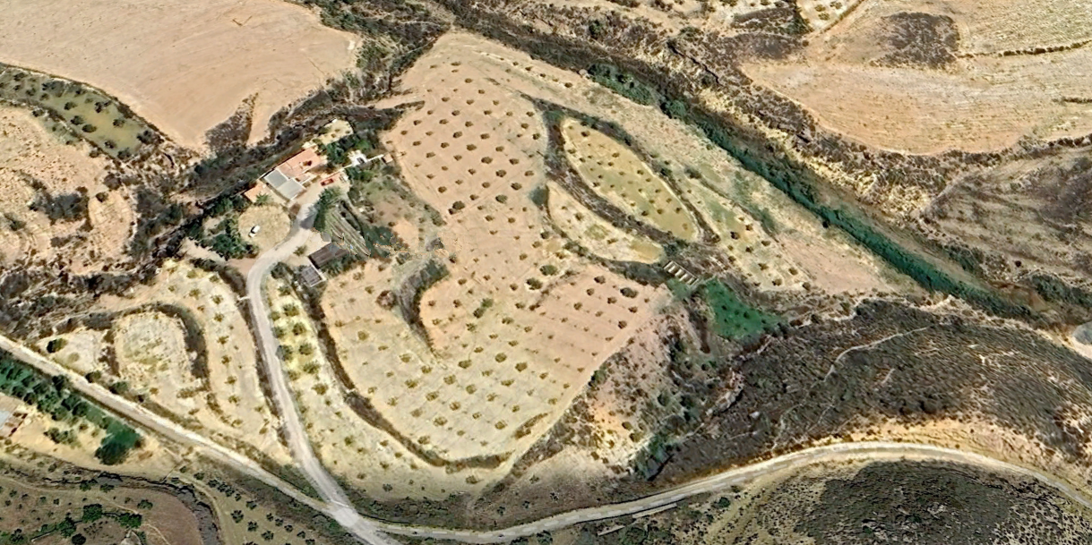
Google-Earth picture of Cerradilla
INorthern boundary the ramba mid-top to mid right
Southern boundary “Via Verde” crossing picture
Western boundary the gorge next to the house
Eastern? Top of the hill/railway cutting to old ford

Slide 4
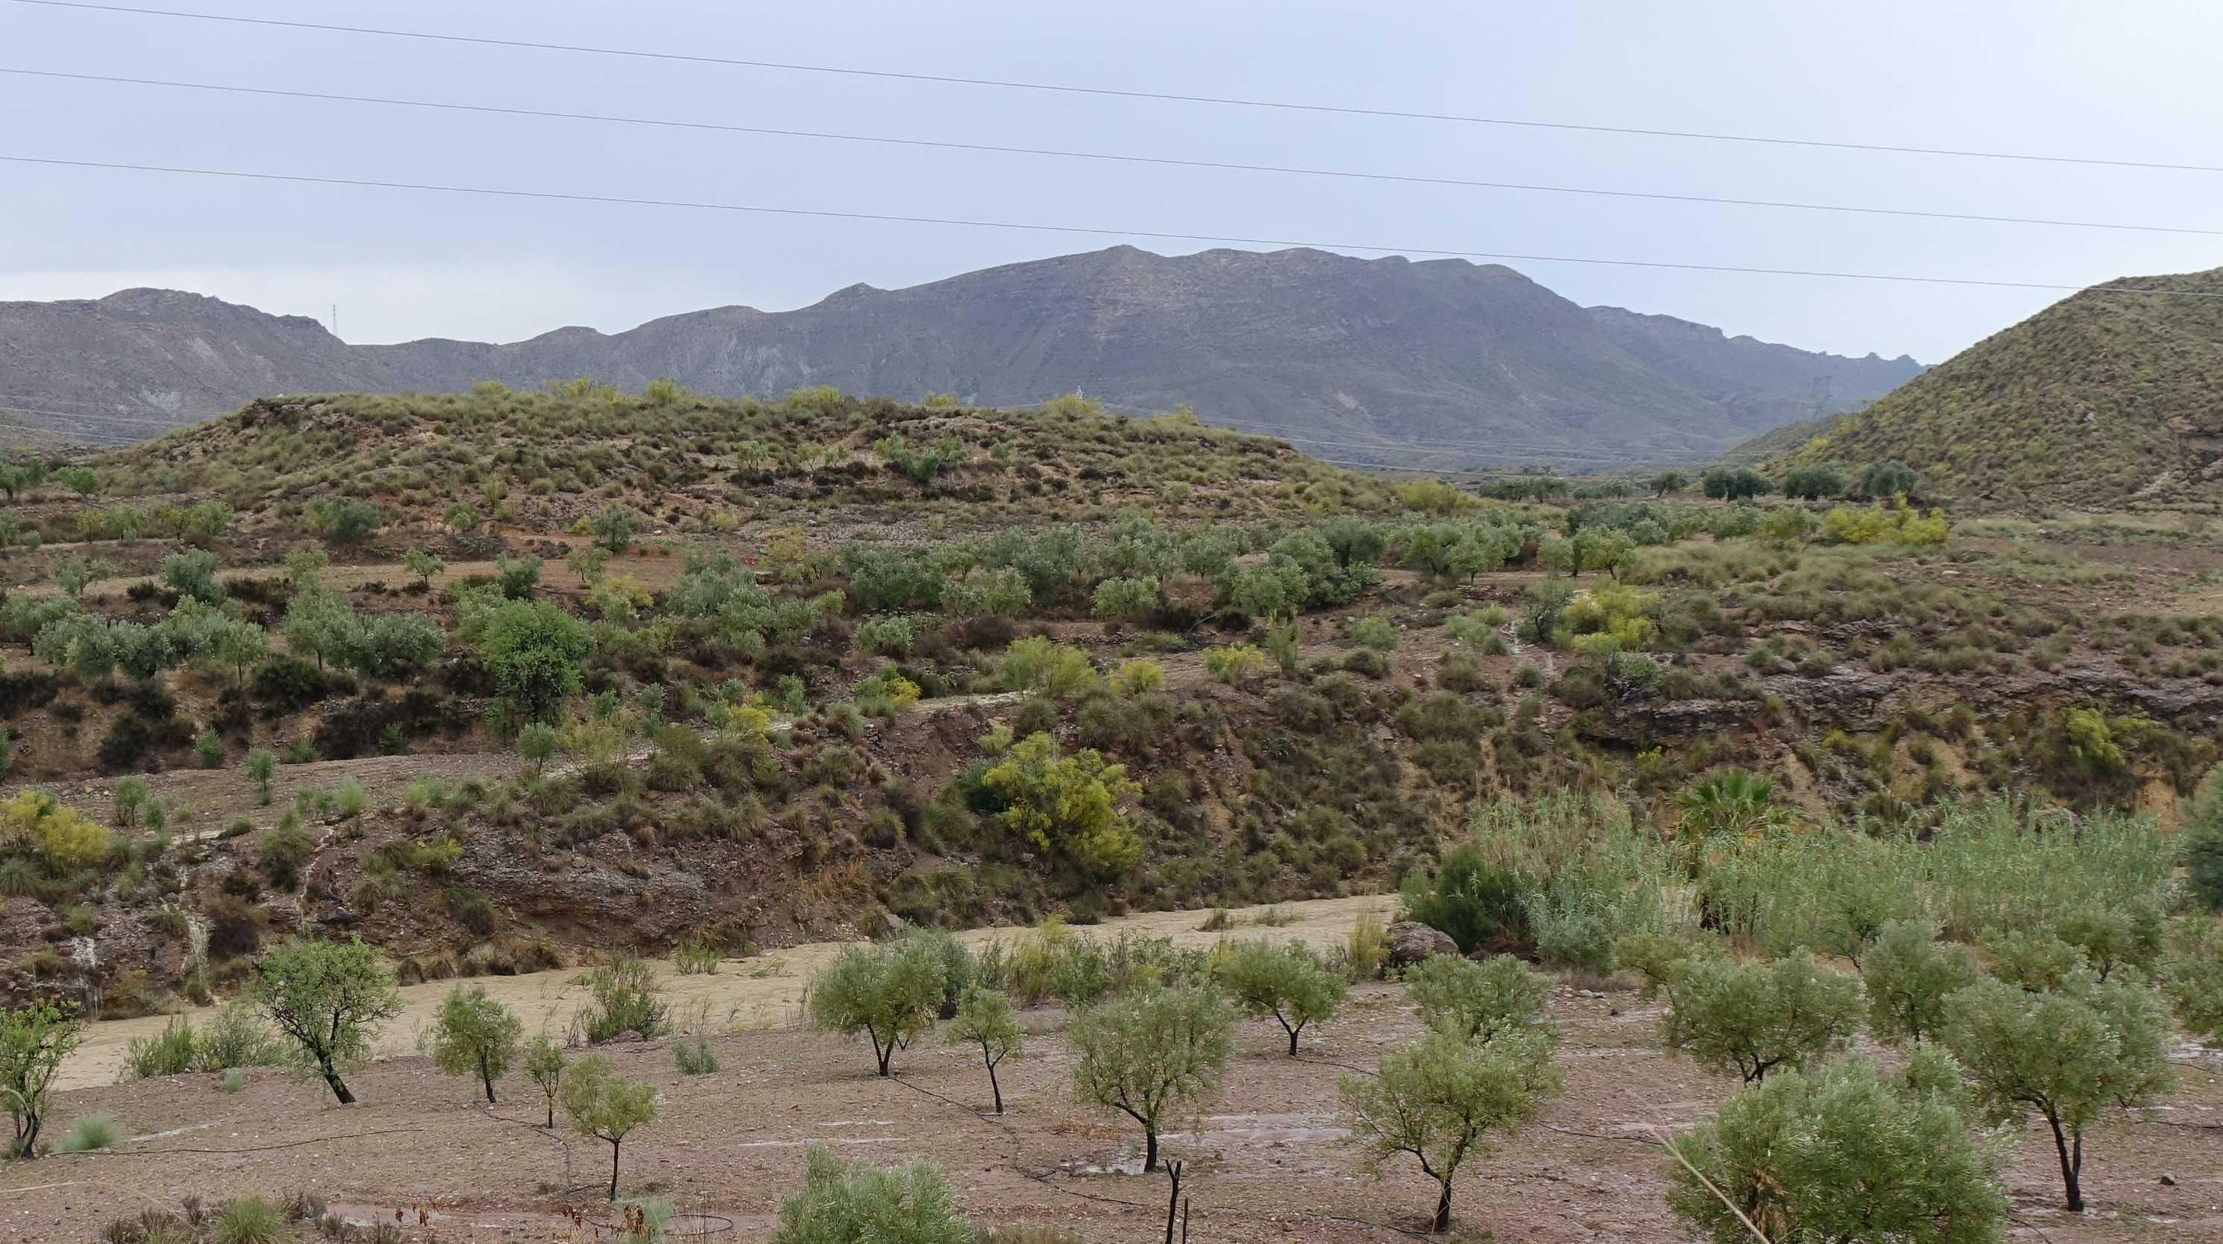
Cerradilla northern boundary
Water finds its lowest level. Normally. So when it rains a lot (well, about once a year) the norther boundary of Cerradilla, the Rambla de Lucainena, ceses to be a dry river bed but maakes its presence obvious!

Slide 5
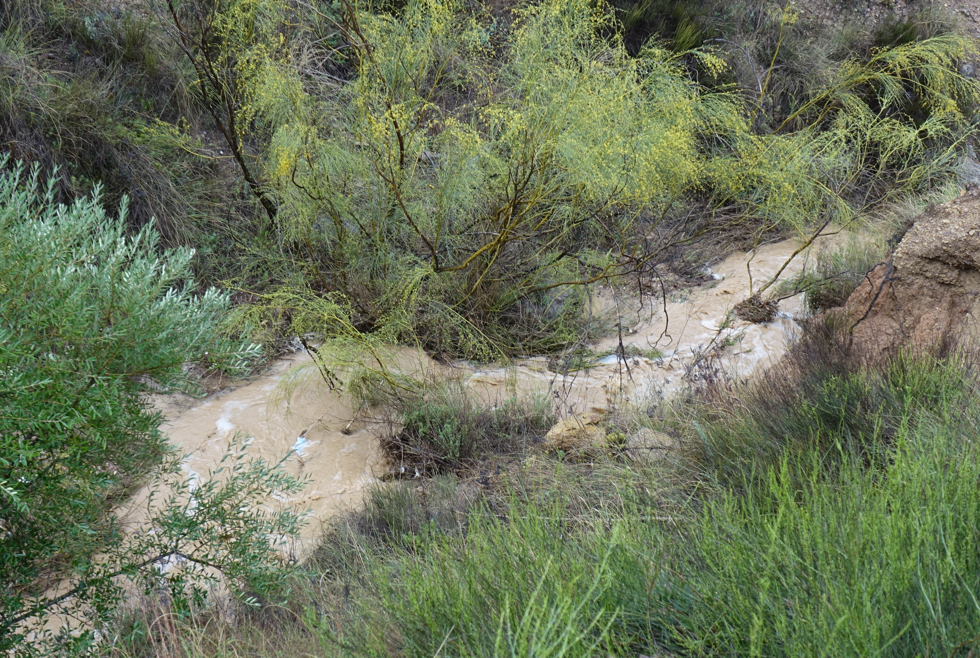
Cerradilla western boundary
Similarly the western boundary simply termed a “barranco” (ravine) can become a raging, noisy torrent when heavy rain arrives..

Slide 6
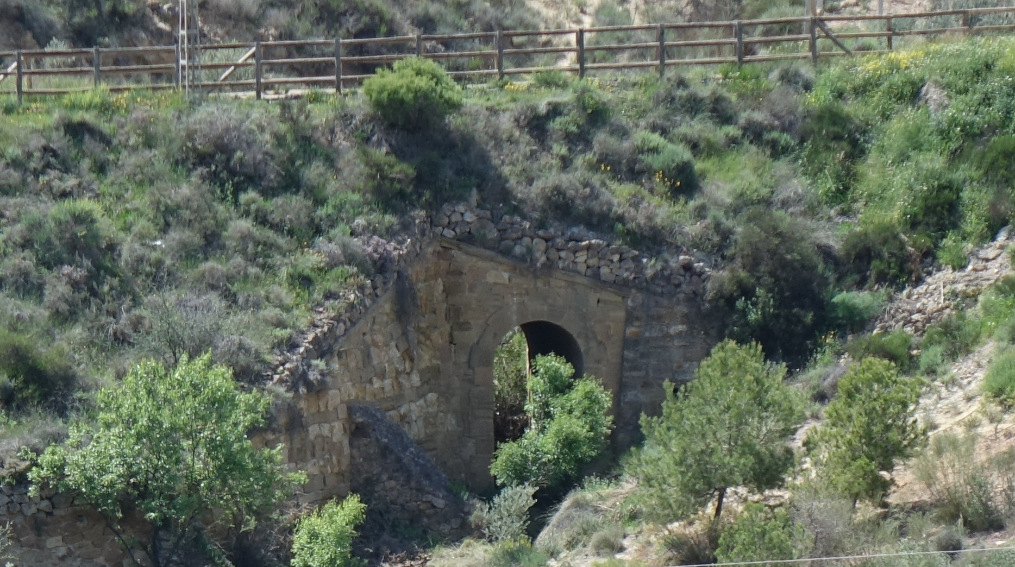
Cerradilla southern boundary
The southern boundary is the old railway line – now a “Via Verde” or pedestrian and cyclists track – which has wooden railings acting as safety fencing. But below it is the well-preserved bridge to let excess rain from yet another “barranco” through. As and when!

Slide 7
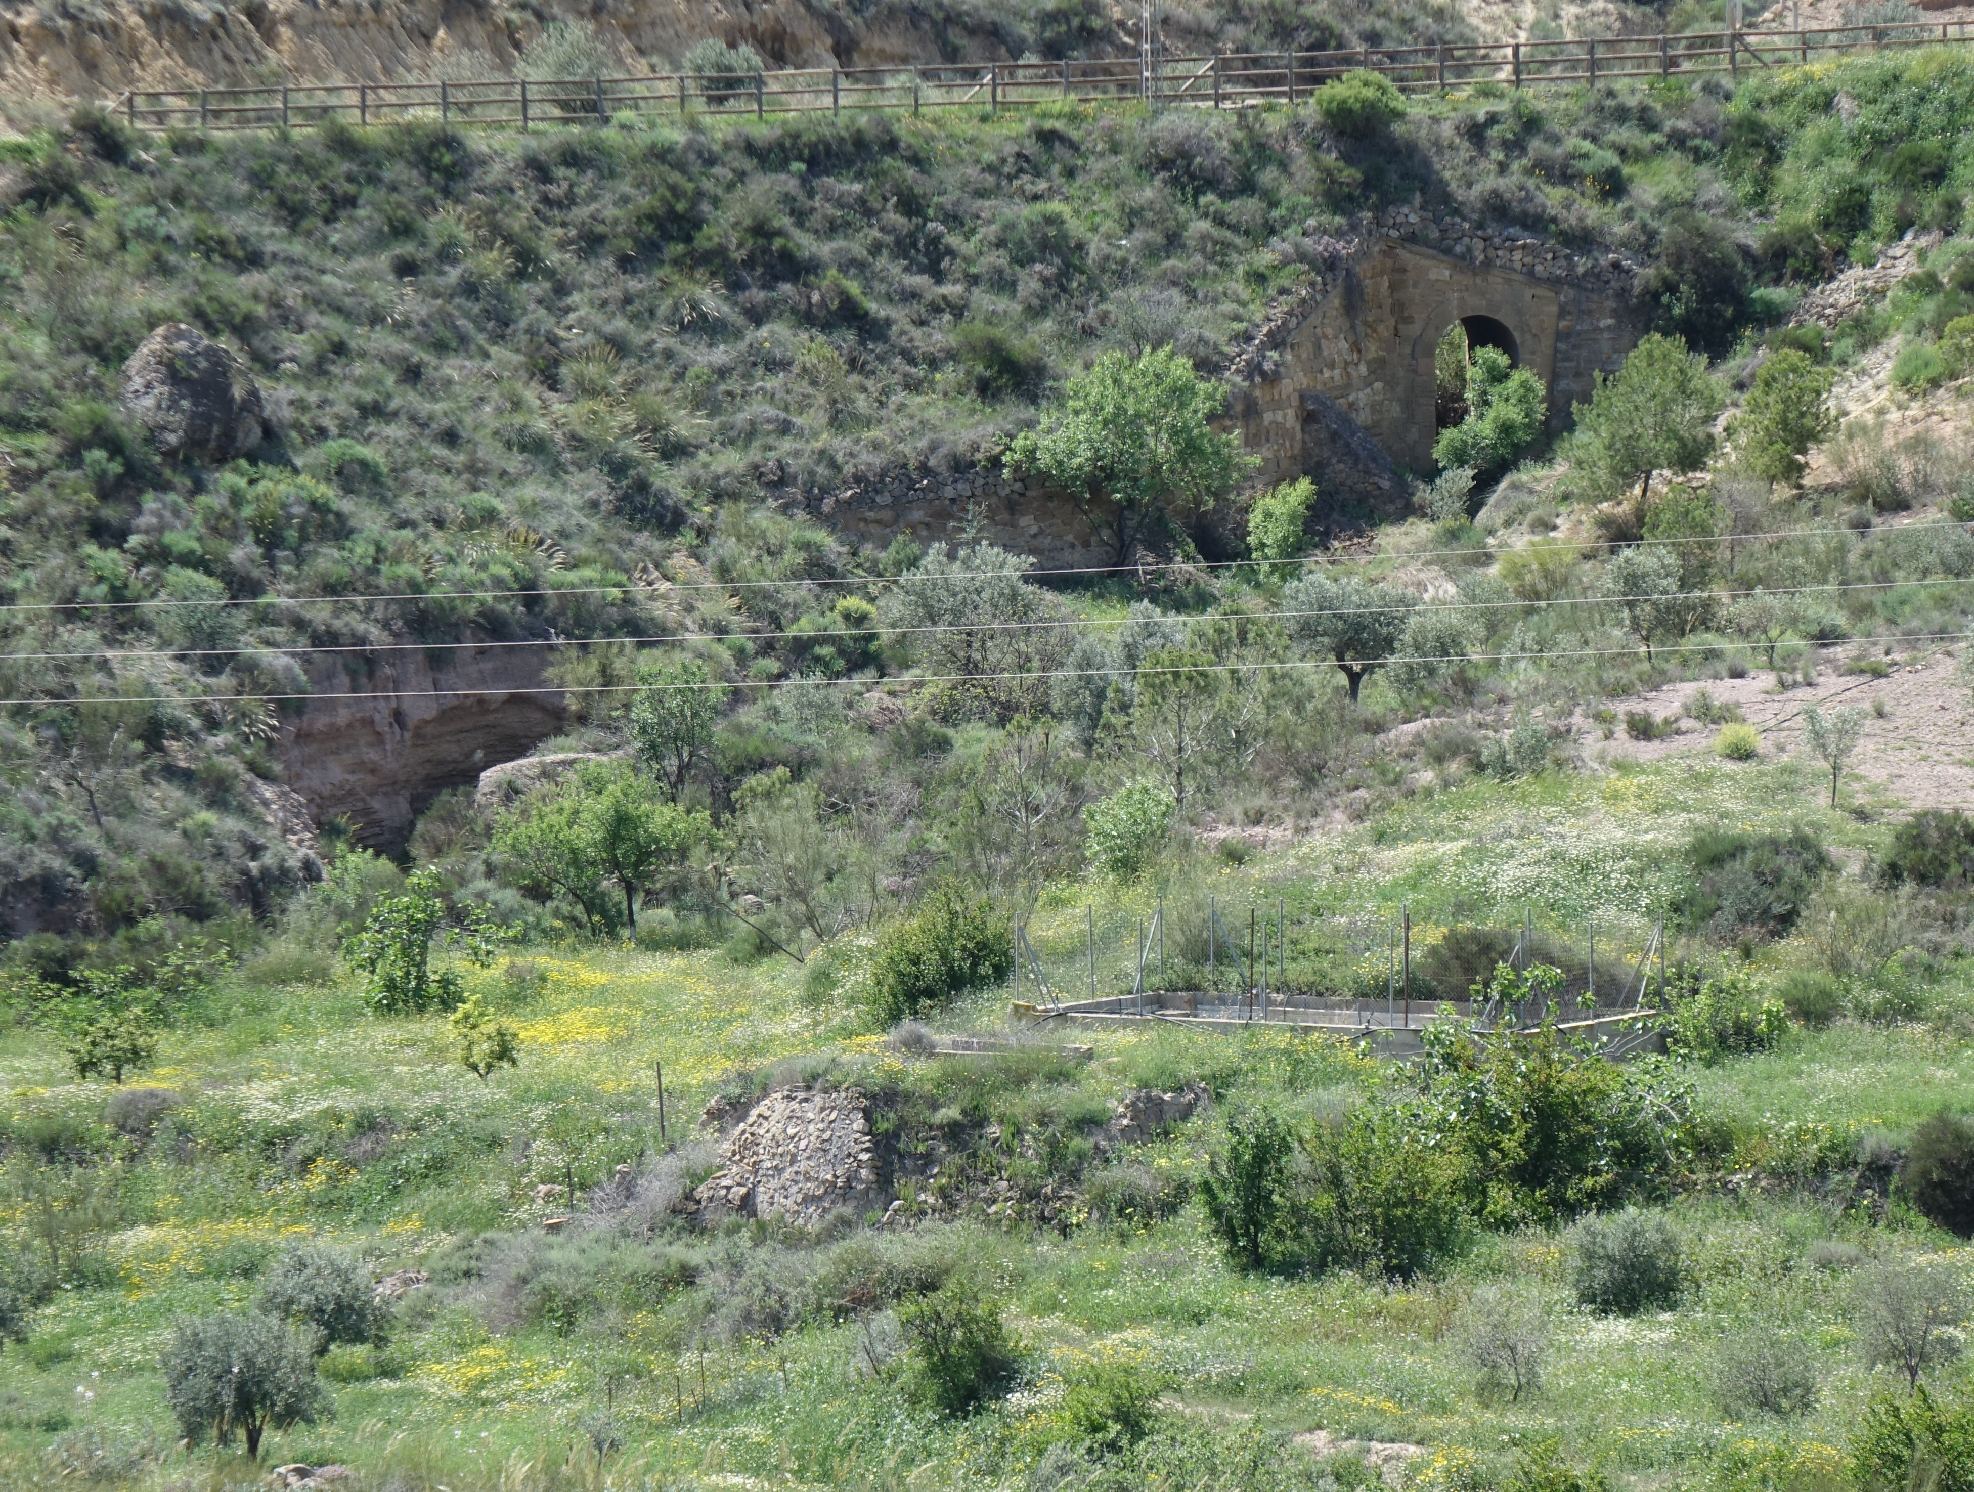
But more information..
To the left is semi-waste ground. Right in the front and to the right are some of the 400 olive trees. Third way up in the middle is the residual old well, and behind it to the right is old “deposito” or reservoir, now converted to an onion-growing garden! To the left is an orange grove, but rather overfull of spring flowers!

Slide 8
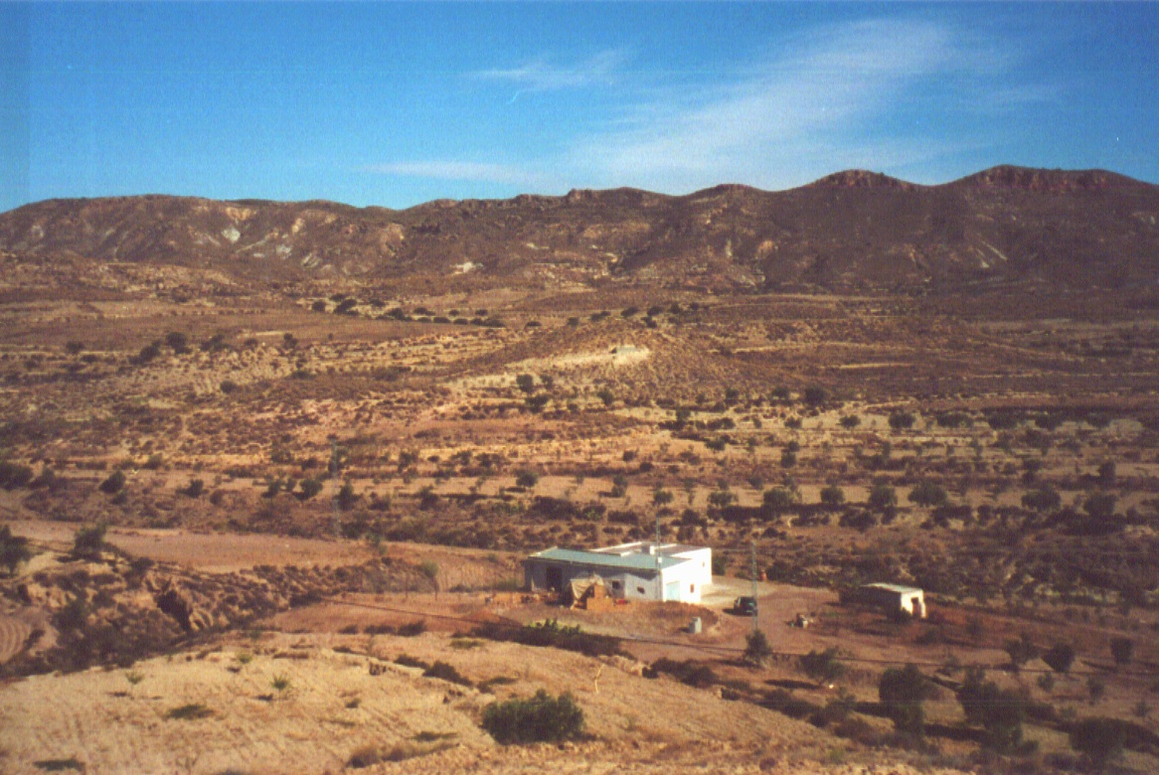
Early days
In October 2000 the cortijo was still a very basic unit.
To the left was a goat shed and to the right a rabbit hutch

Slide 9
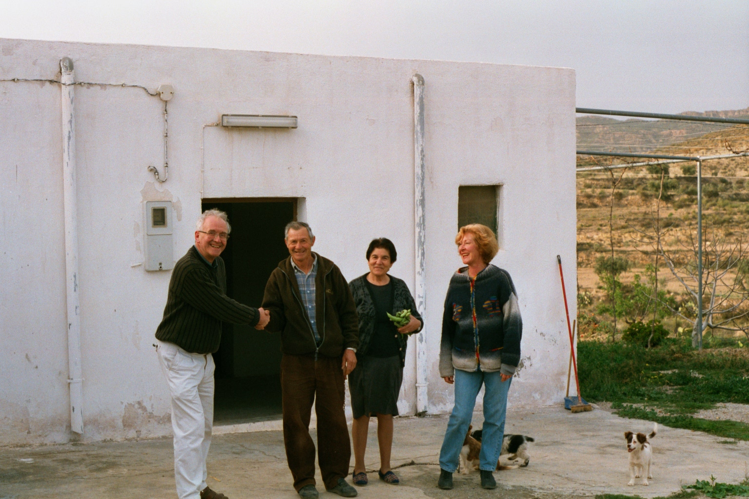
Early days
February 2001 and Rafael & Carmen hand the keys over to Frank whilst
the agent watches. It was her first sale as agent!

Slide 10
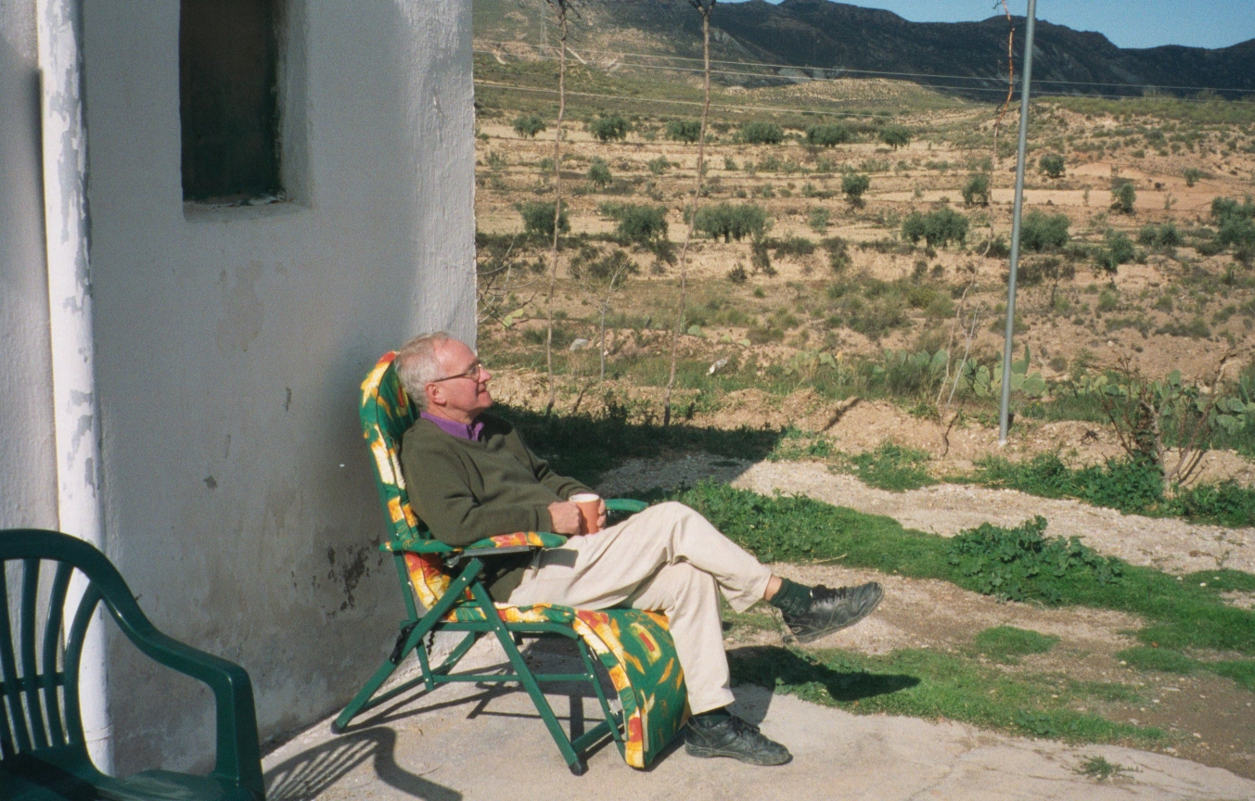
Early days
February 2001 A lot of work work would be required.
But we had managed to buy some chairs and coffee mugs!

Slide 11
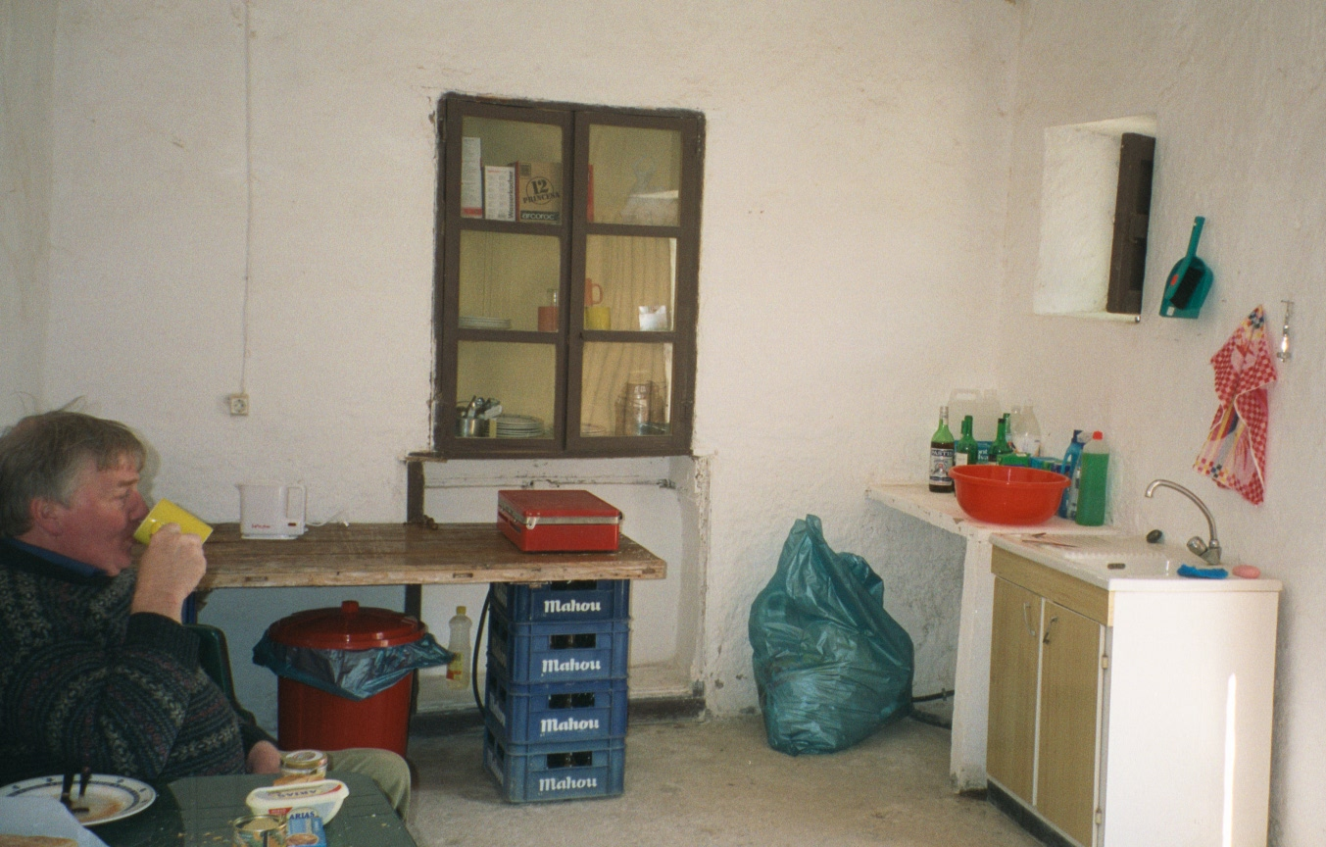
Early days
February 2001 For example, the kitchen was very basic
Eric the “Minder” also enjoyed a coffee.

Slide 12
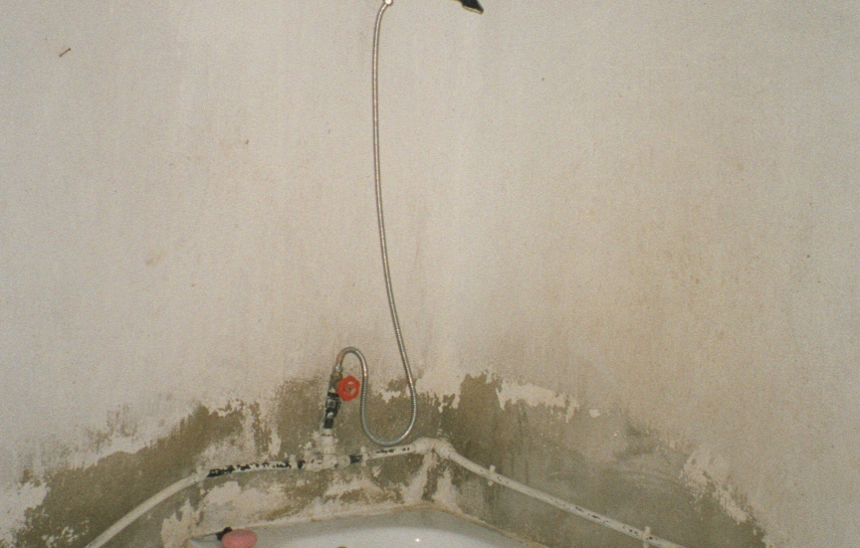
Early days
February 2001 well, there WAS a bath and shower..

Slide 13
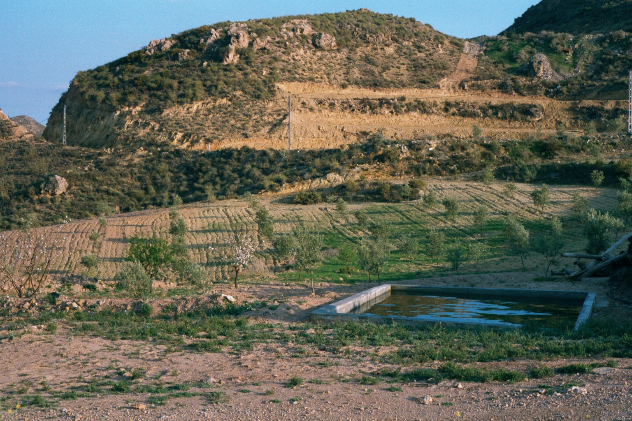
Early days
February 2001 Before irrigation pipes were put down there was “flood irrigation”
and hence the need for these depositos.
But now an example of what was done later on..

Slide 14
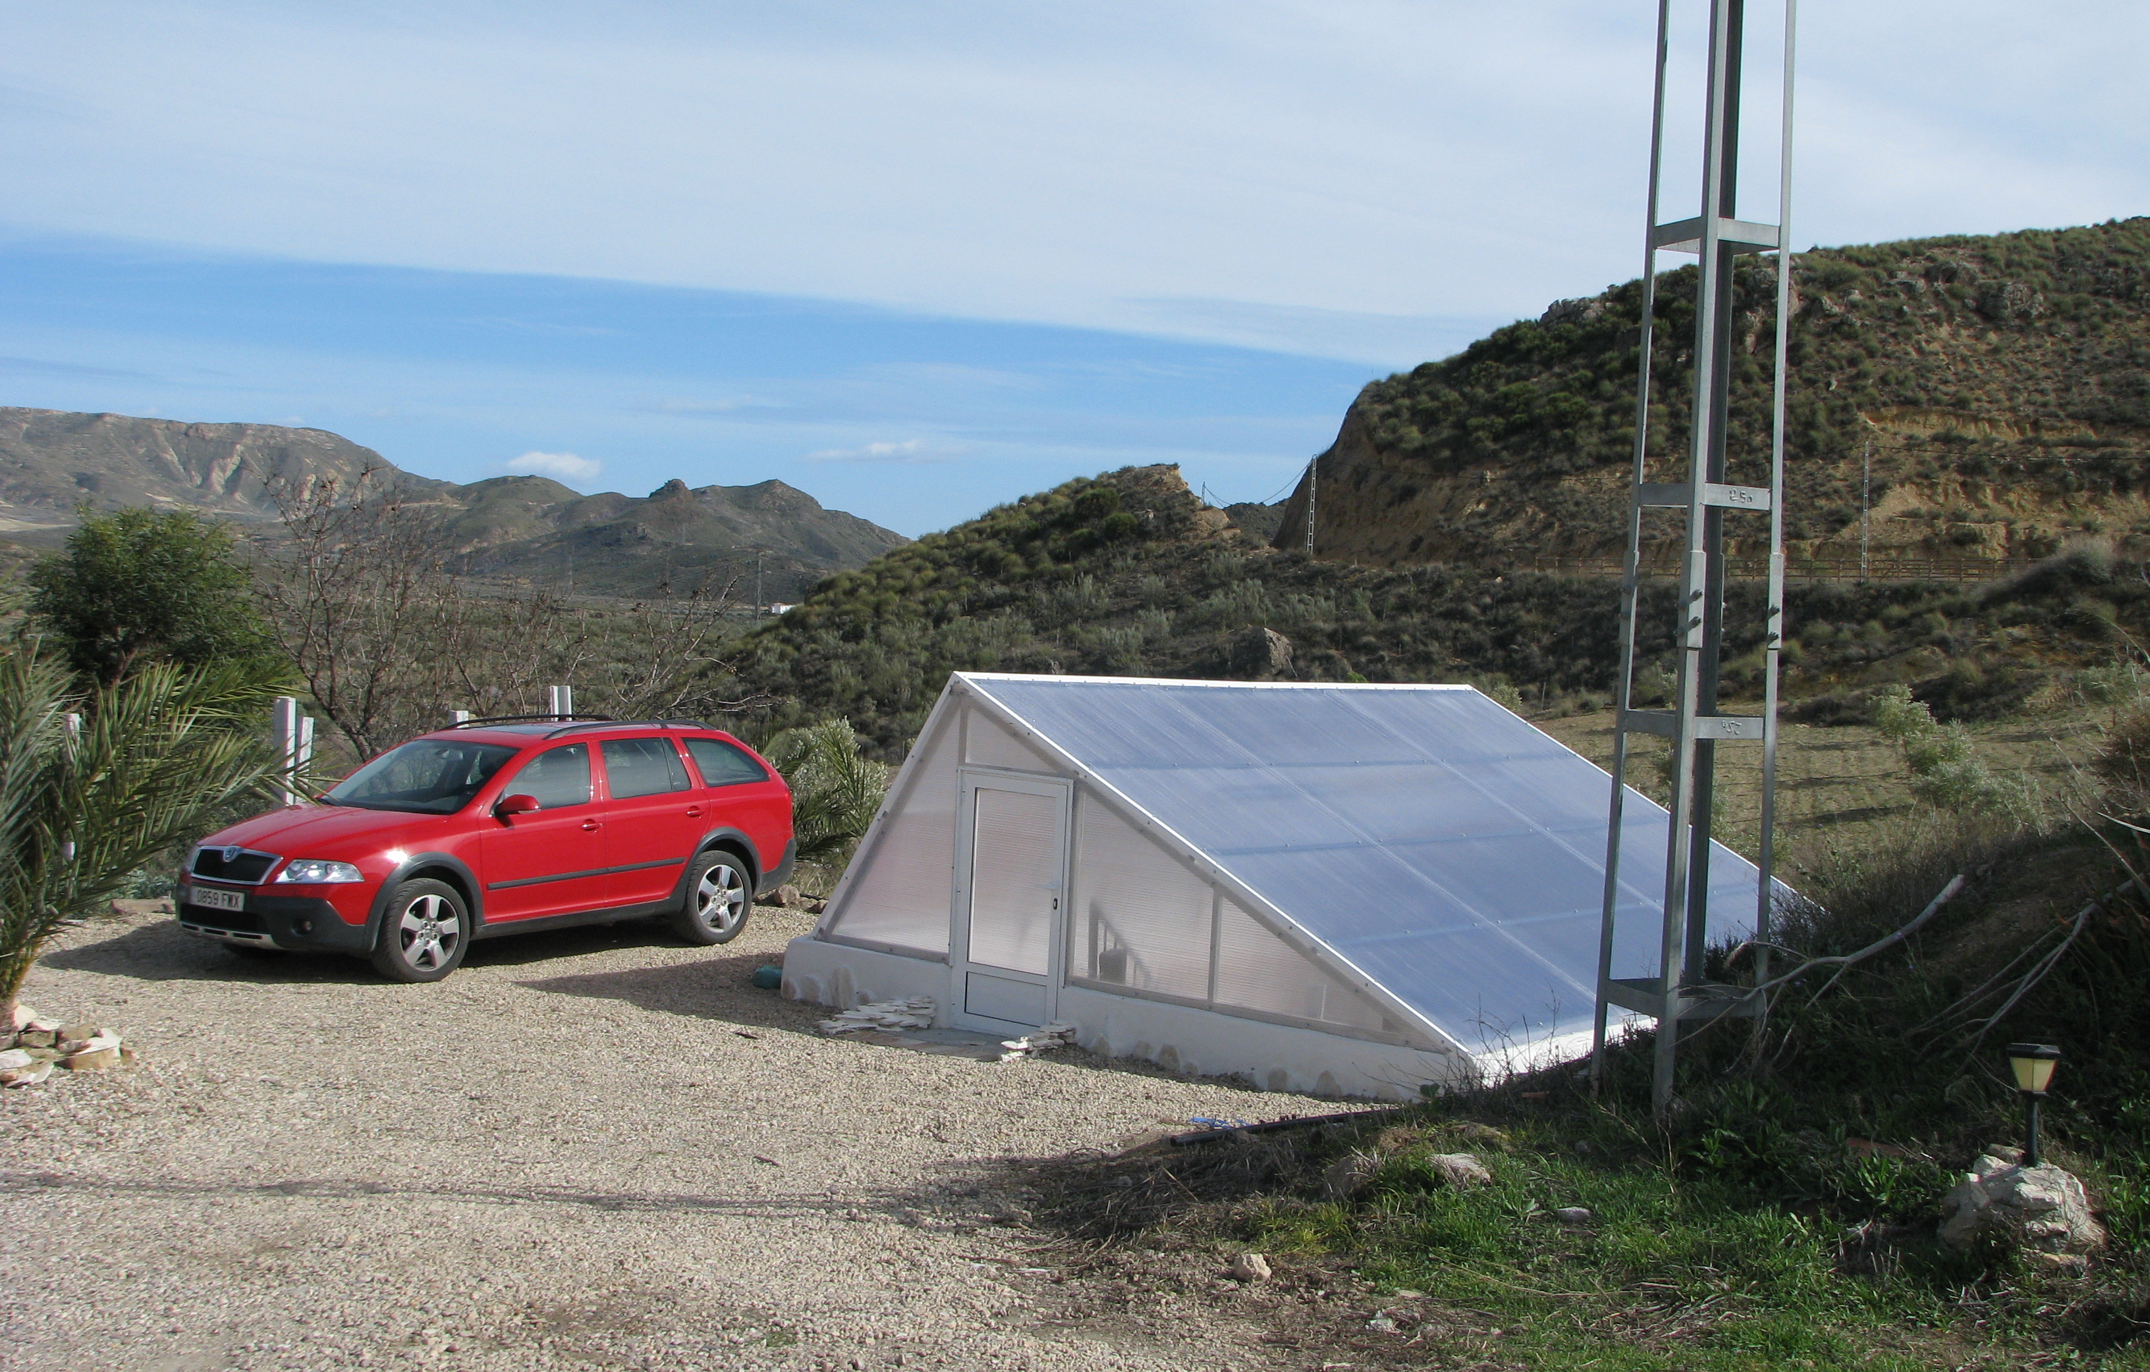
“Greenhouse”
On the top of an old “Deposito” (concrete reservoir)
which no longer had a use we constructed a greenhouse
which allowed for the inside to be relatively cool in summer
and warm in the winter due to the sunken construction

Slide 15
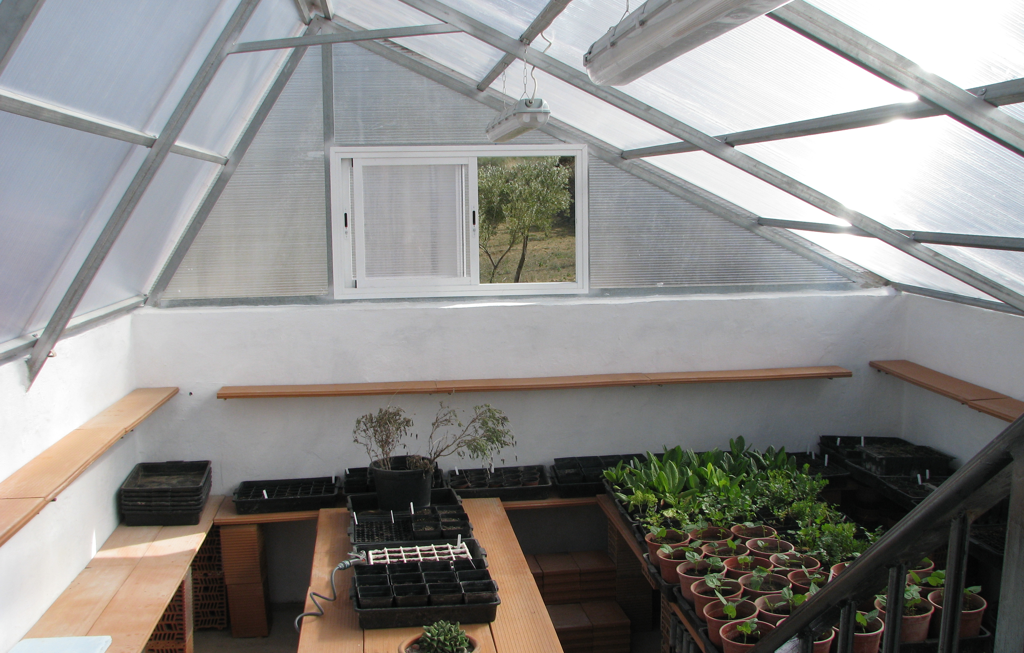
“Greenhouse”
At the start is was very clean and tidy with any seedling
being produced in their flowerpots

Slide 16
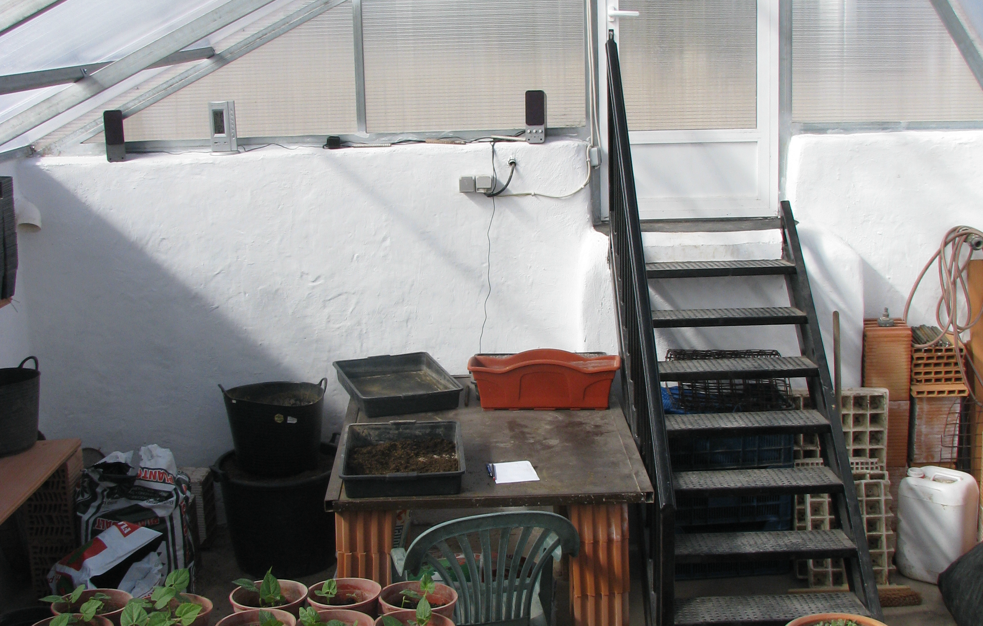
“Greenhouse”
There were stairs down and electricity for allowing
propagators, light for night working
and even music!

